Slide 1
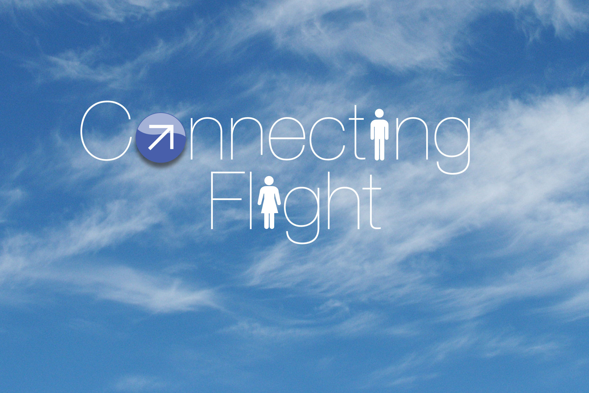
Notes:
Flying for business is pretty awful…long lines, harried staff, flight delays. It shouldn’t so hard. But the hassle starts at home, follows you to the terminal, stays with you on the plane and maybe lets up by the time you get to your meeting.

Slide 2
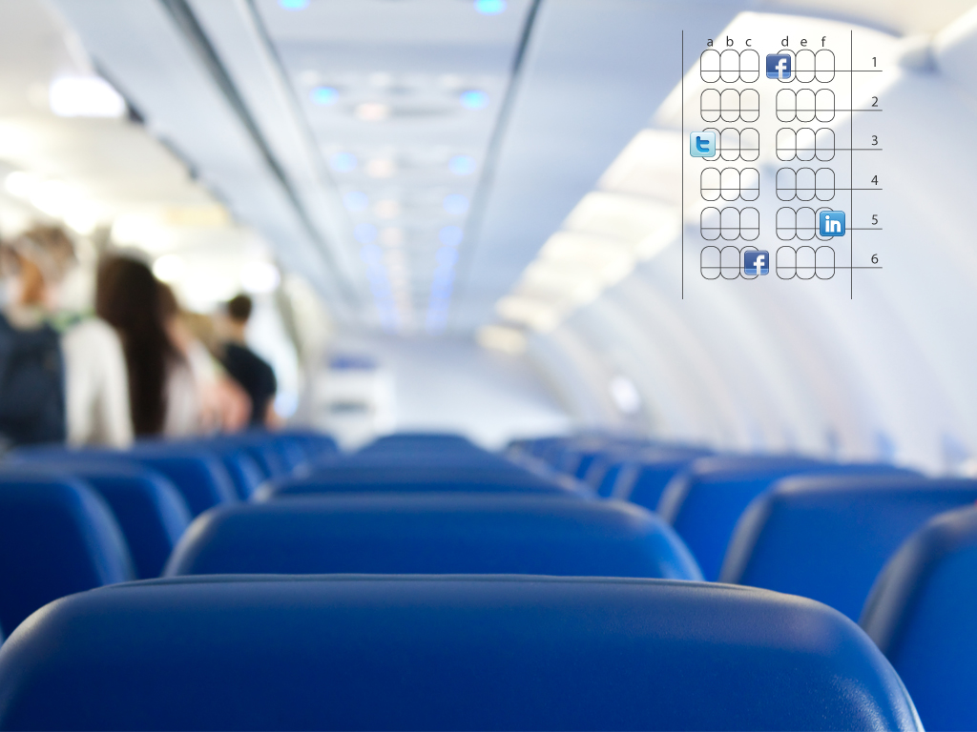
2.7 million people are in the air right now
10,500 will fly through Dallas today
128 people are on your flight
34 fly this route regularly
17 work in your industry
5 are 1 connection away on LinkedIn
1 has the power to sign your next million dollar P.O.
Oh, and he happens to be sitting next to you…

Slide 3
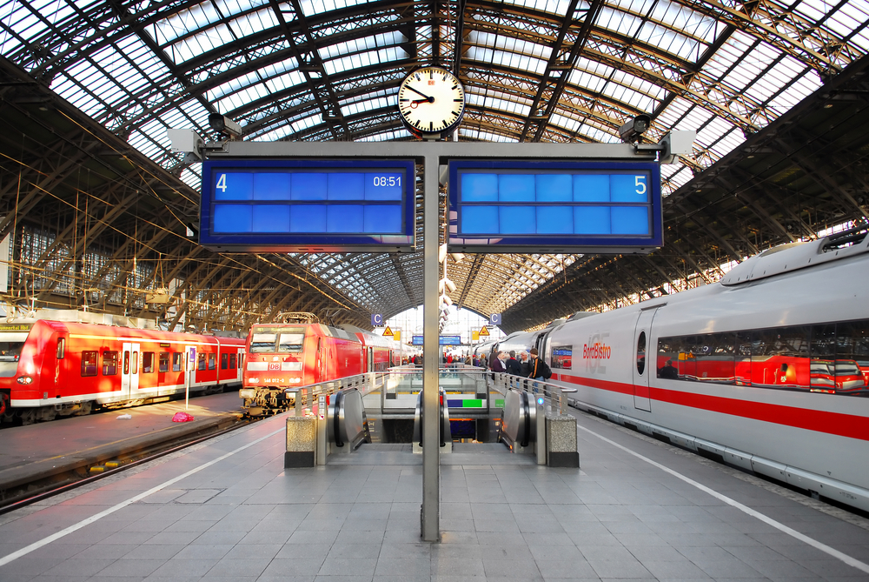
Land at ORD 09:20
Claim bag, make mad dash to train 09:30
Train #415 leaves 09:42
Stand on platform, watching it pull away 09:45
Train #416 leaves 12:42
What if you never had to go through that again?

Slide 4
Concept Statement
What if an airline did business your way for a change? Focused less on your credit card, and more on creating a painless travel experience. Saw the value in knowing you—and knowing people who travel like you do. At every touchpoint, made getting there and back easier, kicked aggravation to the curb, and proved that business travel doesn’t have to feel like business as usual. It’d be amazing.

Slide 5

10AM Monday meeting in Paris. (Very Important)
We flew in from Brussels. London. New York. Vancouver. And Hong Kong.
Connecting Flight made sure we all got to Paris between 6:30 and 7:15. So we had time for a run-through. And a croissant.

Slide 6
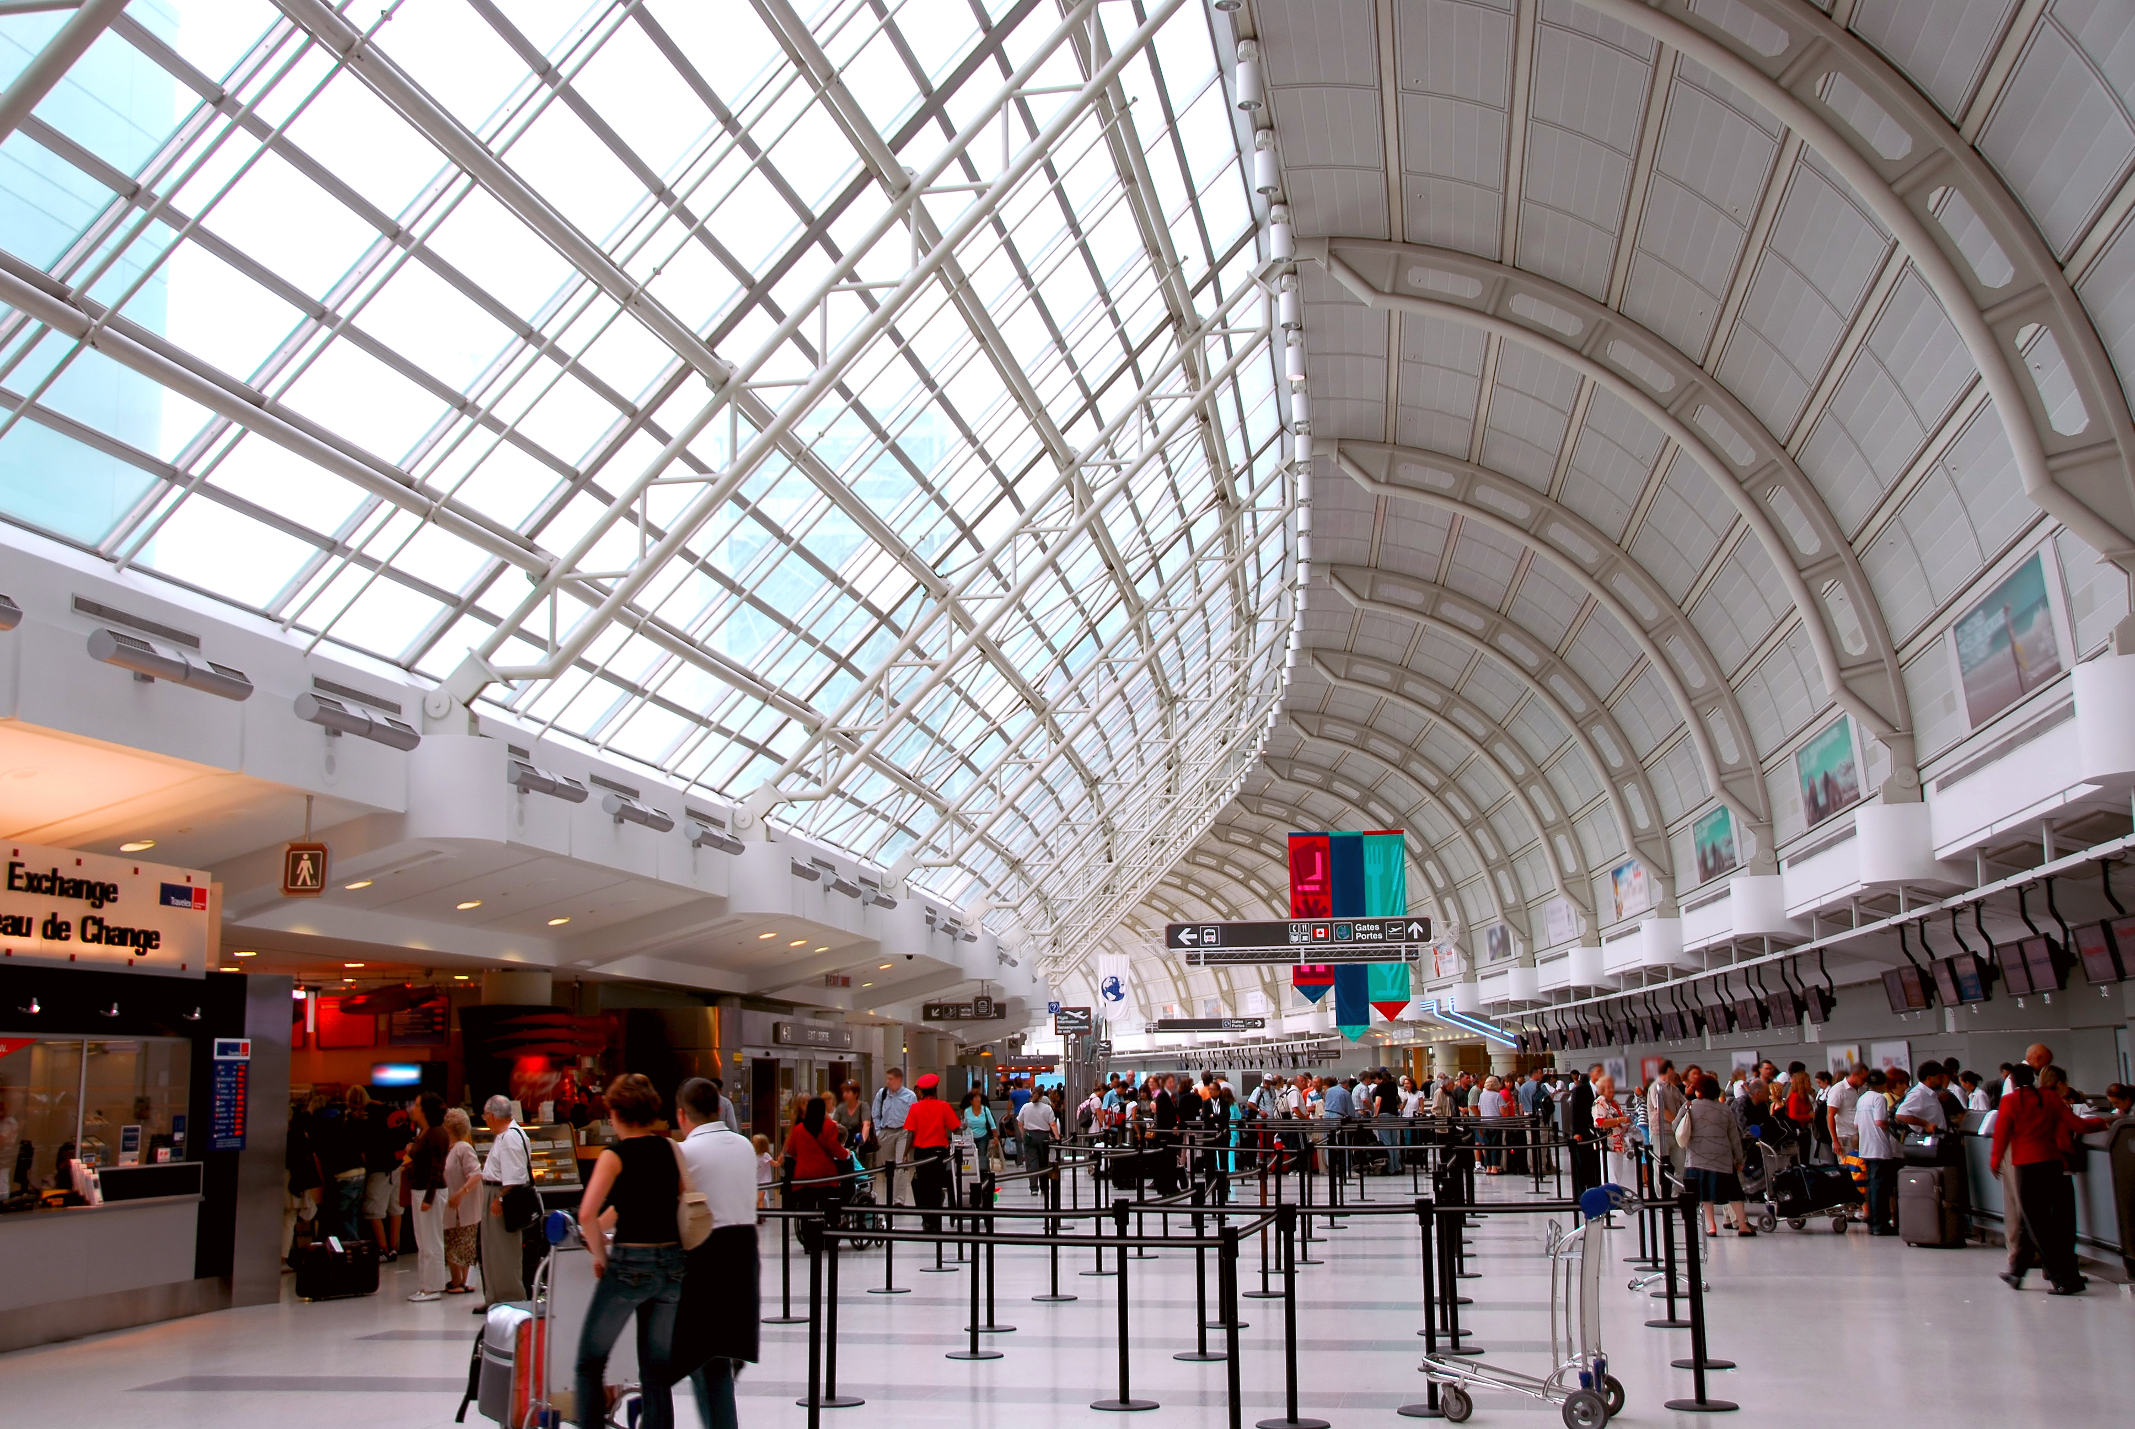
They read my mind.
Or at least they read my message.
Connecting Flight lets members of the cloud keep each other in the loop—and uses the real-time feedback to fix things like long lines.

Slide 7
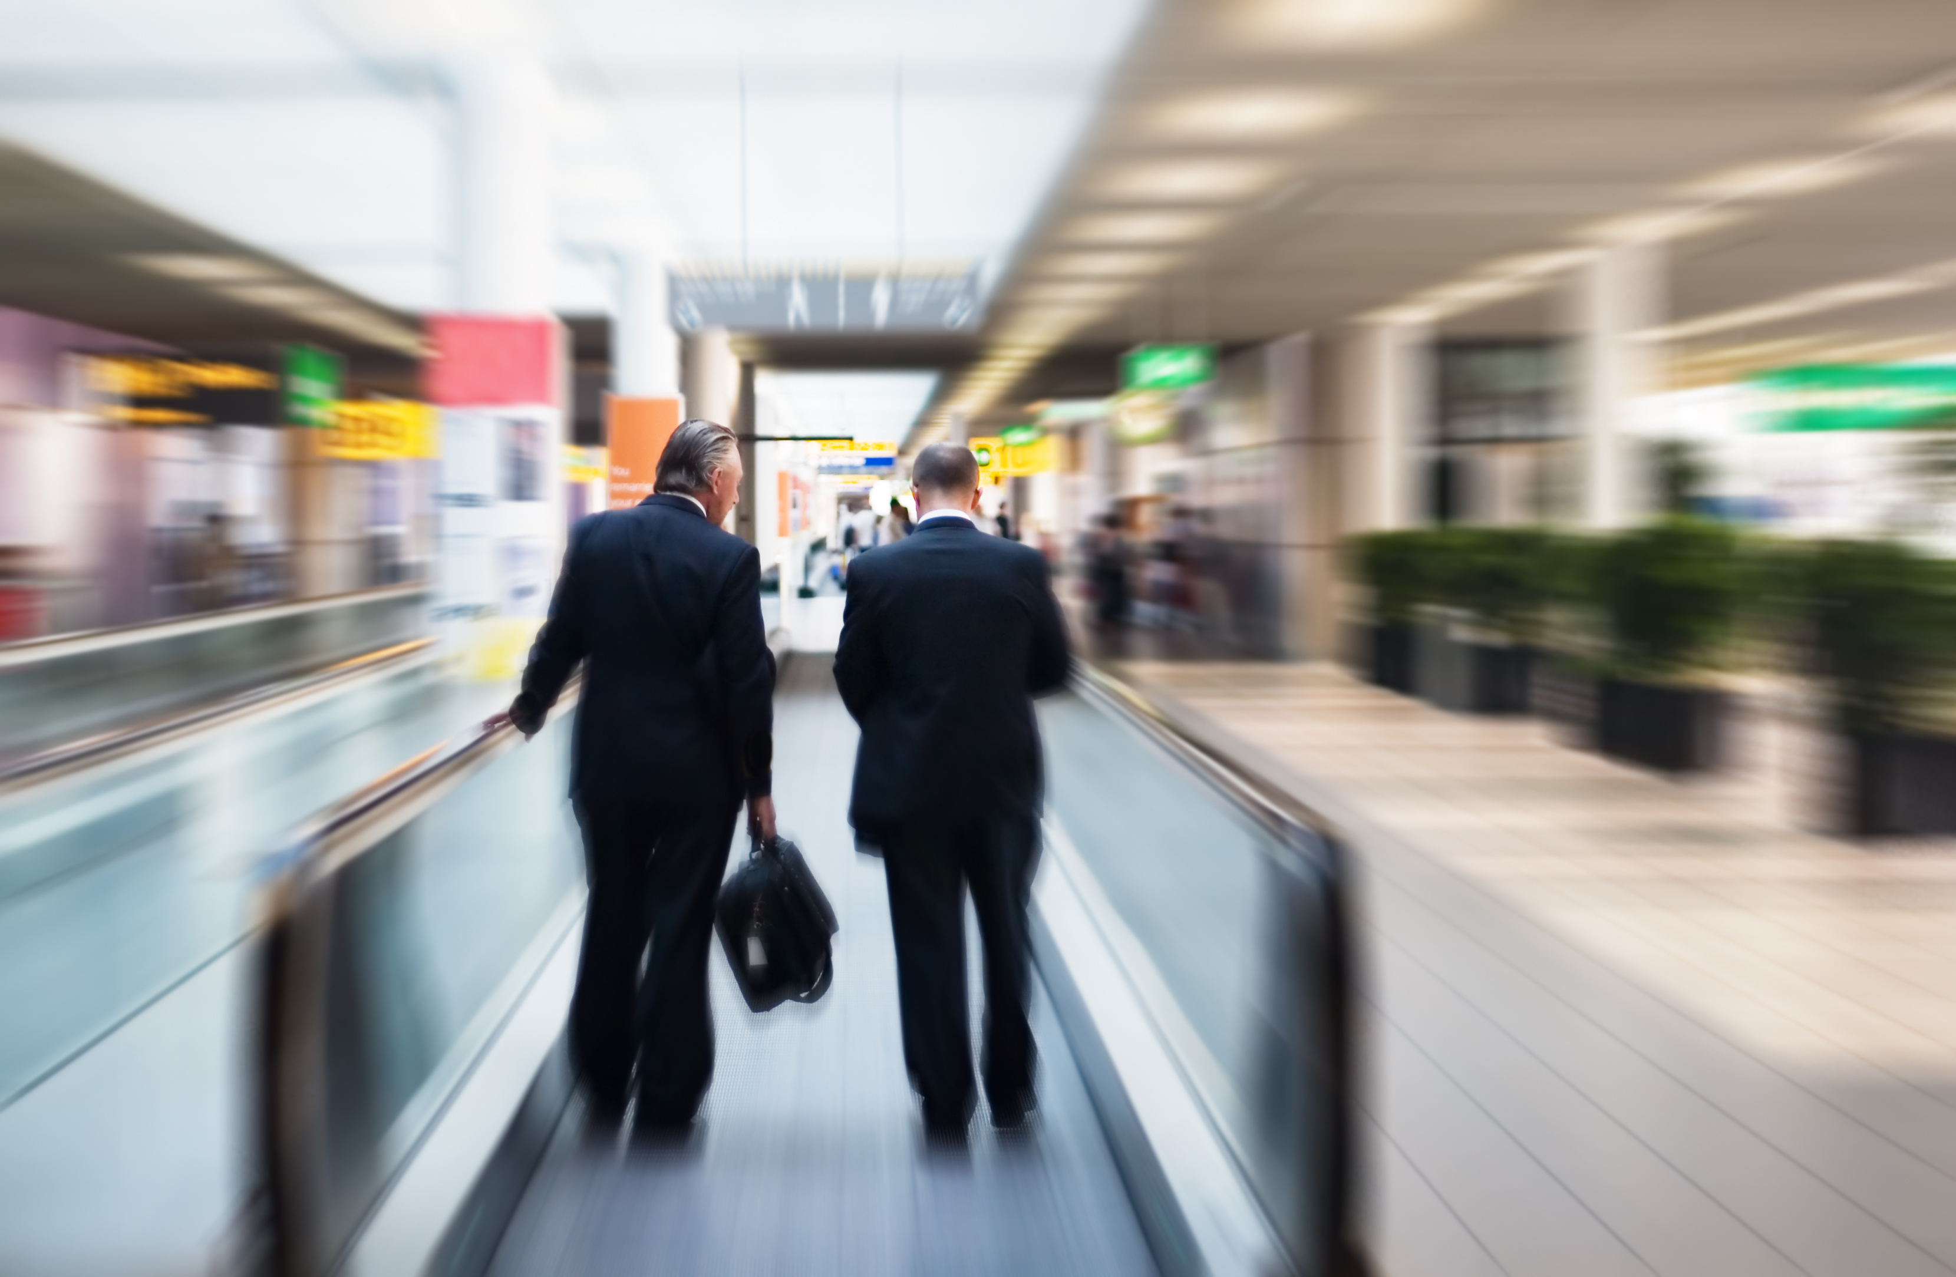
What are the odds?
That guy standing right behind you? He’s a CMO. And you have 18 common LinkedIn connections.
Connecting Flight integrates with all your social networks so you can network more efficiently.

Slide 8
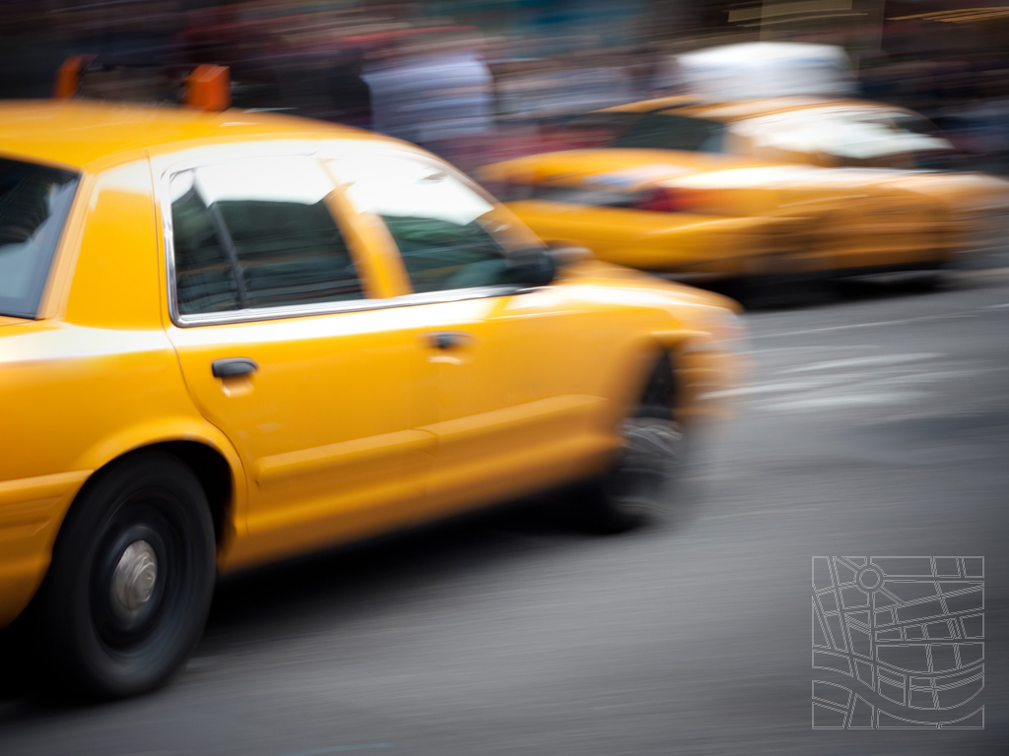
Saving green. And saving green.
3 other people on your flight are heading to your hotel. Sharing a taxi makes a lot of sense.
Connecting Flight spots opportunities to help your company save on things like travel expenses. And does the Earth a solid, too.

Slide 9
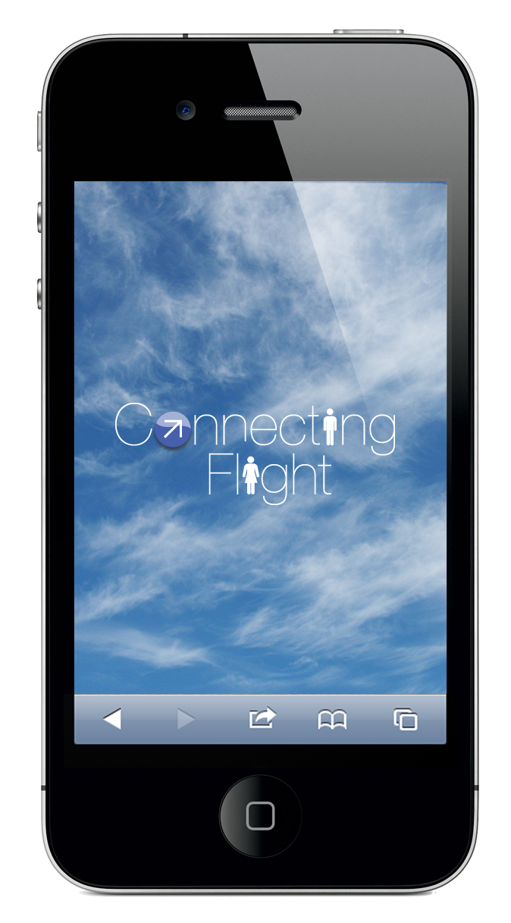
Customer Value
Unlocks a community of relevant contacts that was previously unreachable within your existing social networks
Actual customer feedback and behavior data drives the creation of a personalized flight experience that keeps learning over time
Accumulation of data drives a more efficient, more pleasurable and potentially cheaper travel process

Slide 10
Airline Value
Real-time, continuous user feedback provides opportunities for quick-hit improvements
In-depth customer information enables a more tailored, targeted marketing approach
Creates a new community based on the way you travel and how people like you travel
Multiple consumer touchpoints (Mobile, iDevice, Website, Kiosks, Seatback Screen) open the door to new partnerships

Slide 11
You’re already doing business in the clouds.
Shouldn’t the cloud help you do business?
Notes:
Flying for business is pretty awful…long lines, harried staff, flight delays. It shouldn’t so hard. But the hassle starts at home, follows you to the terminal, stays with you on the plane and maybe lets up by the time you get to your meeting.

Slide 12
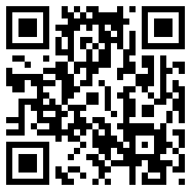
Schadenfreude
Brian Jones | Joe Morrow
Kathryn Kemmis | Sangeeta Saxena
Travis Lutz
12

